Slide 1
2. Models of Knowledge Graphs
John P. McCrae
CT5166

Slide 2
Course structure
9th Sep | Introduction to Knowledge Graphs | 21st Oct | Inductive reasoning
16th Sep | Models for Knowledge Graphs | 28th Oct | KG Creation (no lab on Monday)
23rd Sep | Querying and Serialization | 4th Nov | KG Alignment
30th Sep | Schemas | 11th Nov | Publishing and Linked Open Data
7th Oct | Deductive reasoning | 18th Nov | Linguistic Linked Open Data
14th Oct | No Lecture | 25th Nov | Enterprise Knowledge Graphs

Slide 3
Graphs

Slide 4
From relations to graphs
Name | County | Country | Population | Area
Galway | Galway | Ireland | 80k | 54km²
Dublin | Dublin | Ireland | 554k | 117km²
Cork | Cork | Ireland | 210k | 187km²
How to make this a graph?
Galway
name
county
Co. Galway
country
id0001
Ireland
population
80k
area
54km²

Slide 5
Directed edge-labelled graphs
Ireland
locatedIn
Galway
memberOf
EU
Directed: The edges have a direction
Labelled: There are different types of edges

Slide 6
Directed Edge-Labelled Graphs
A directed edge-labelled graph is a tuple G=(V, E, R), where V is a set of nodes, R is a set of edge labels and E ⊆ V ✕ R ✕ V

Slide 7
Heterogeneous graphs
Ireland
locatedIn
Galway
memberOf
EU
Heterogeneous: Each node has a label
A heterogeneous graph is a tuple G=(V, E, R, L, l), where V is a set of nodes, L is a set of labels and E ⊆ V ✕ R ✕ V and l: V ∪ R → L

Slide 8
Property Graphs
Ireland
locatedIn
Properties: Allow nodes to have numeric, textual and other properties
Galway
population
80k
A property graph is a tuple G=(V, E, R, L, P, U, E’, l), where V is a set of nodes, L is a set of labels, P and R are sets of properties and U is a set of values and E ⊆ V ✕ R ✕ V and E’ ⊆ V ✕ P ✕ U and l: V ∪ R ∪ P → L

Slide 9
Graph Datasets
Cities
Countries
A graph dataset is a pair G = (G_{D}, N) where G_{D} is the default graph and N = {(n₁, G₁), …, (n_{k}, G_{k})} is a set of named graphs

Slide 10
Discussion
What else might we want to model with graphs?
What information could we not easily capture with the formalism above?

Slide 11
Other graph formalisms
Hypergraphs: Edges can connect more than two nodes
Reified graphs: Edges can be used as nodes
Nested graphs: Graphs can be used as nodes
Temporal graphs: Each edge is a assigned a time in which it is valid
Provenance graphs: Each edge is annotated with a source statement (used by Wikidata).

Slide 12
Resource Description Framework

Slide 13
RDF Data Model
Resource Description Framework (RDF) implements a graph dataset of heterogeneous, directed, edge-labelled property graphs.
Initially designed to represent metadata on the Web
Foundational data model for both Semantic Web and Linked Data
RDF Statements are expressed by triples
subject predicate object

Slide 14
Example
http://john.mccr.ae/
http://xmlns.com/foaf/0.1/name
“John P. McCrae”@en
foaf:depiction
foaf:knows
http://john.mccr.ae/me.jpg
Nigel Collier
https://www.mml.cam.ac.uk/nhc30

Slide 15
RDF vs Relational (SQL) Model
RDF is
Semi-structured: no prescribed schema
Self-describing: individual RDF documents include schema information
Traditional (SQL) databases:
Fixed schema
Schema and data are separate

Slide 16
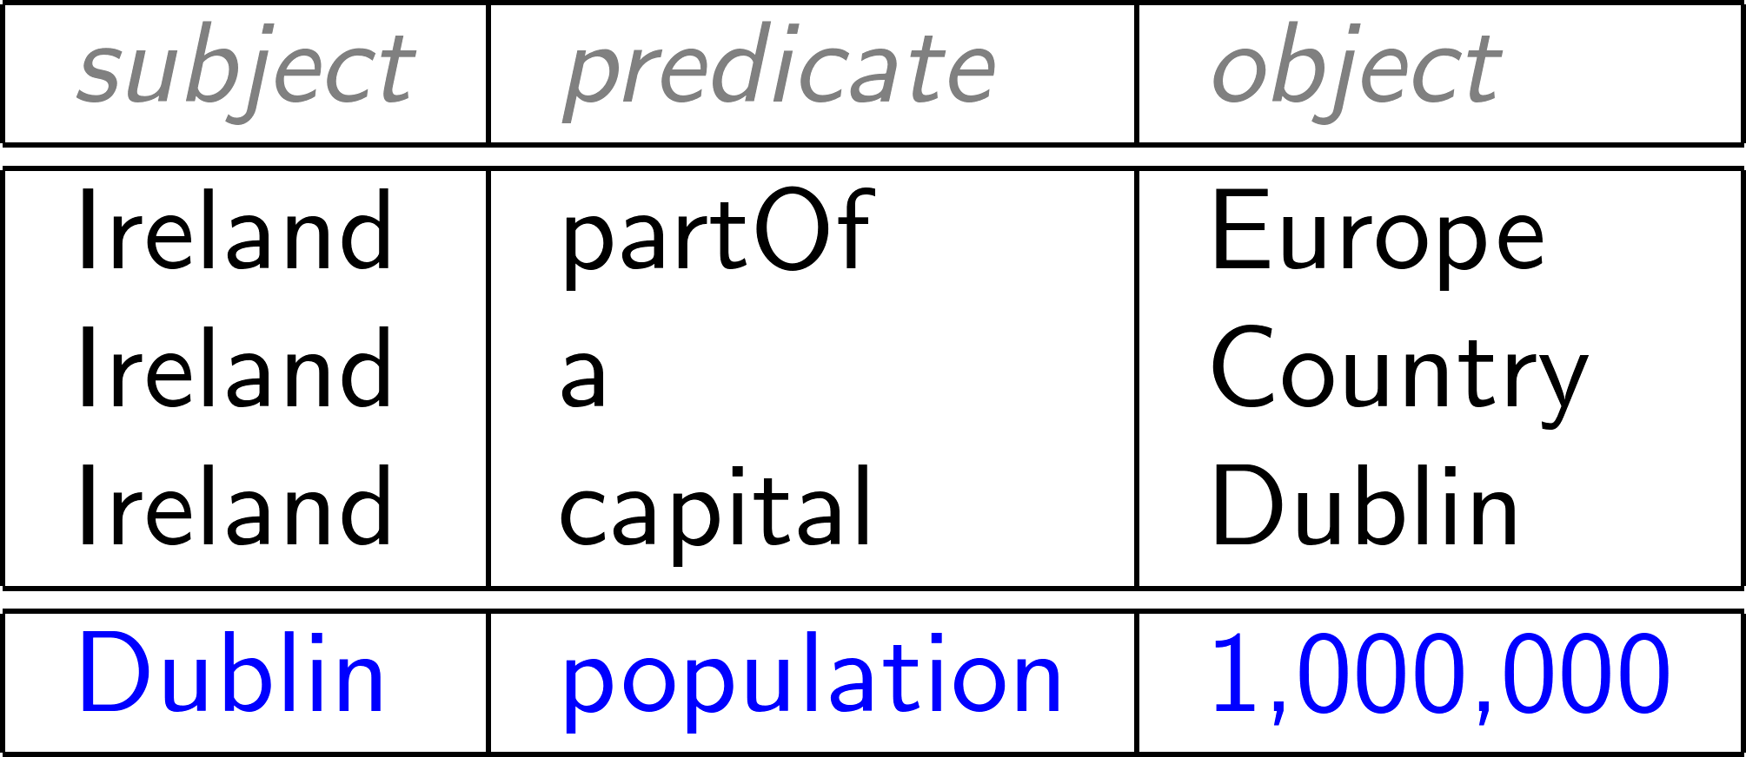
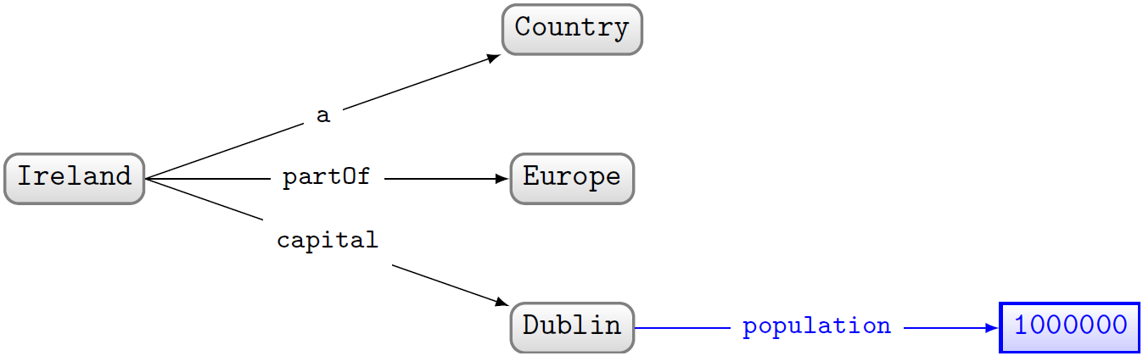
RDF can be drawn as a graph

Slide 17
Task
Draw a graph modelling some facts about NUI Galway

Slide 18
Need unambiguous symbols/identifiers
Since we’re on the Web … use Web identifiers
URL: Uniform Resource Location
The location of a resource on the Web
http://ex.org/Eire.html
URI: Uniform Resource Identifier (RDF 1.0)
Need not be a location, can also be a name
http://ex.org/%C3ire
IRI: Internationalised Resource Identifier (RDF 1.1)
A URI that allows Unicode characters
http://ëx.org/Éire = http://xn--x-ega/%C3ire
I will only talk about URIs for this course

Slide 19
Uniform Resource Locators (URLs)
Domain/Authority
Query
http://www.example.com/path/to/file?query#identifier
Protocol
Path
Fragment

Slide 20
Examples of other valid URLs
ftp://ftp.is.co.za/rfc/rfc1808.txt
http://www.ietf.org/rfc/rfc2396.txt
ldap://[2001:db8::7]/c=GB?objectClass?one
mailto:John.Doe@example.com
news:comp.infosystems.www.servers.unix
tel:+1-816-555-1212
telnet://192.0.2.16:80/
urn:oasis:names:specification:docbook:dtd:xml:4.1.2

Slide 21
Relative URLs
URLs may be resolved relative to the Base URL (e.g., the URL used to find the document)
<http://www.example.com/path/to/file#identifer>
<//www.example.com/path/to/file#identifer> </path/to/file#identifer> <file#identifer> <#identifer>

Slide 22
IRIs with prefixes
CURIESs = Compact URIs
<http://ex.org/Dublin> ↔ ex:Dublin
"ex:" denotes a prefix for http://ex.org/
"Dublin" is the local name

Slide 23
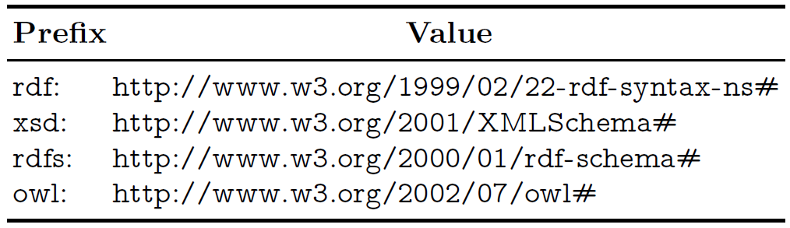
Frequently used prefixes
Look up any prefix at https://prefix.cc/

Slide 24
From strings...

Slide 25
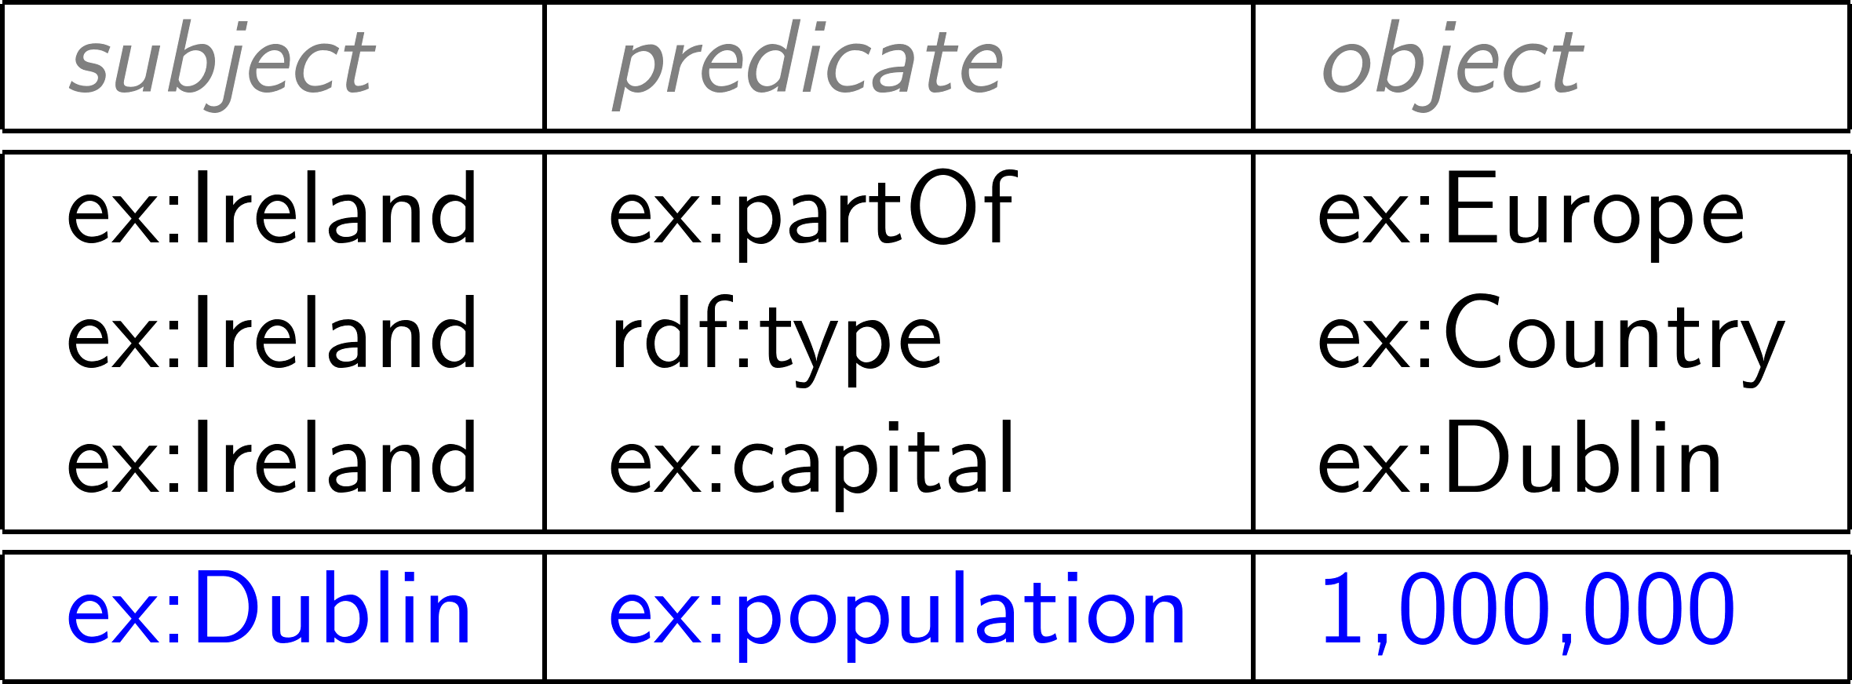
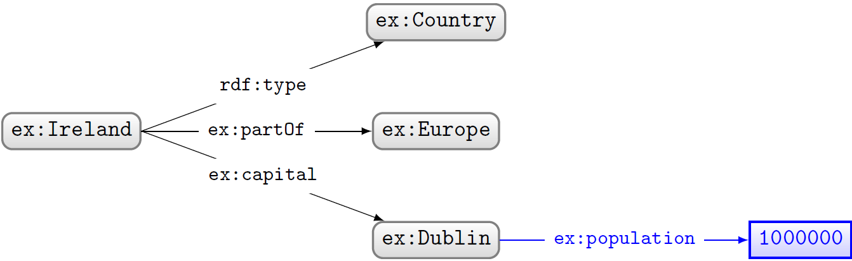
...to URIs

Slide 26
What about numbers?
Should we assign URIs to numbers?

Slide 27
Linked Open Numbers
Someone actually did this!
http://km.aifb.kit.edu/projects/numbers/web/n1000
This was originally meant as a joke though…
What are the disadvantages of using URIs for numbers?

Slide 28
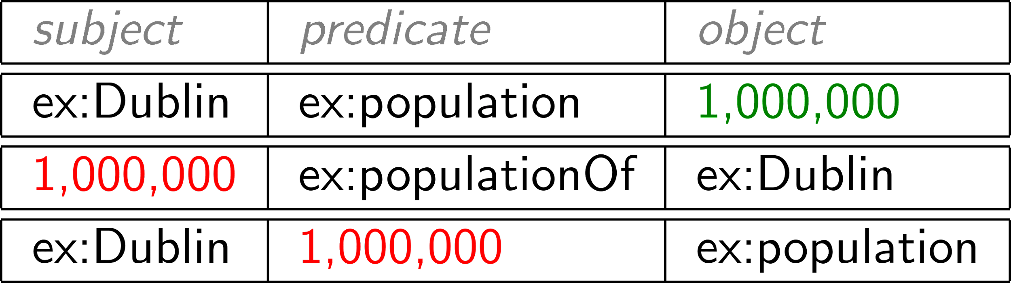


RDF Literals
Literals are for datatype values, like strings, numbers, booleans, dates, times
Only allowed in object position

Slide 29
Datatype literals
“lexical-value”^^ex:datatype
“200”^^xsd:int
“2014-12-13”^^xsd:date
“true”^^xsd:boolean
“this is a string”^^xsd:string
If the datatype is omitted, it’s a plain literal
“this is a string” (NB not the same as “this is a string”^^xsd:string)
“200” is a string, not a number!

Slide 30
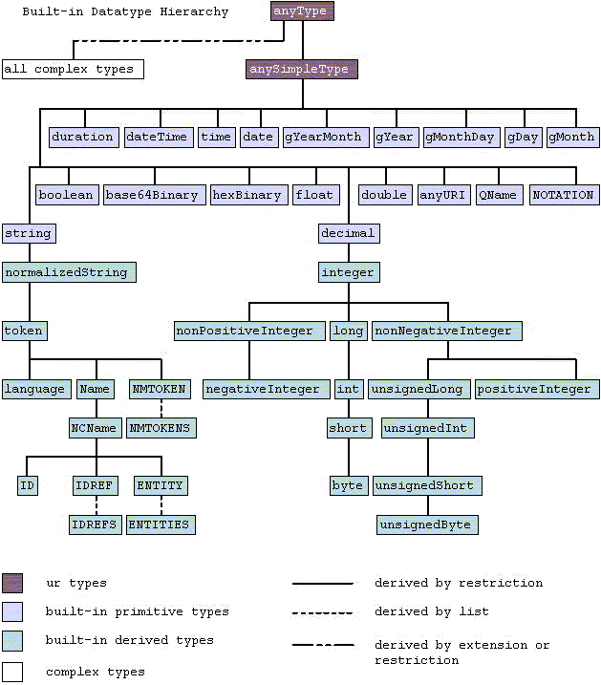
Datatypes
RDF uses XML Schema Descriptions (XSD)
Custom datatypes are allowed in OWL

Slide 31
Datatypes
Boolean: true/false or 0/1
Temporal: date, time, dateTime, duration
Numeric: int, double, float, decimal, unsigned
string, XML name, Base64, HTML, XML

Slide 32
Language-tagged strings
Specify that a string is in a given language
“string”@lang-tag
No datatype!
“Ireland”@en “Éire”@ga
Should be used for all natural language content

Slide 33
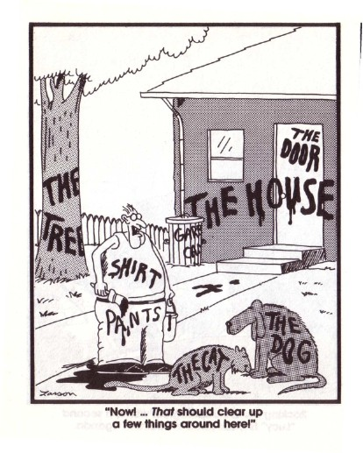
Having to name everything is hard work

Slide 34
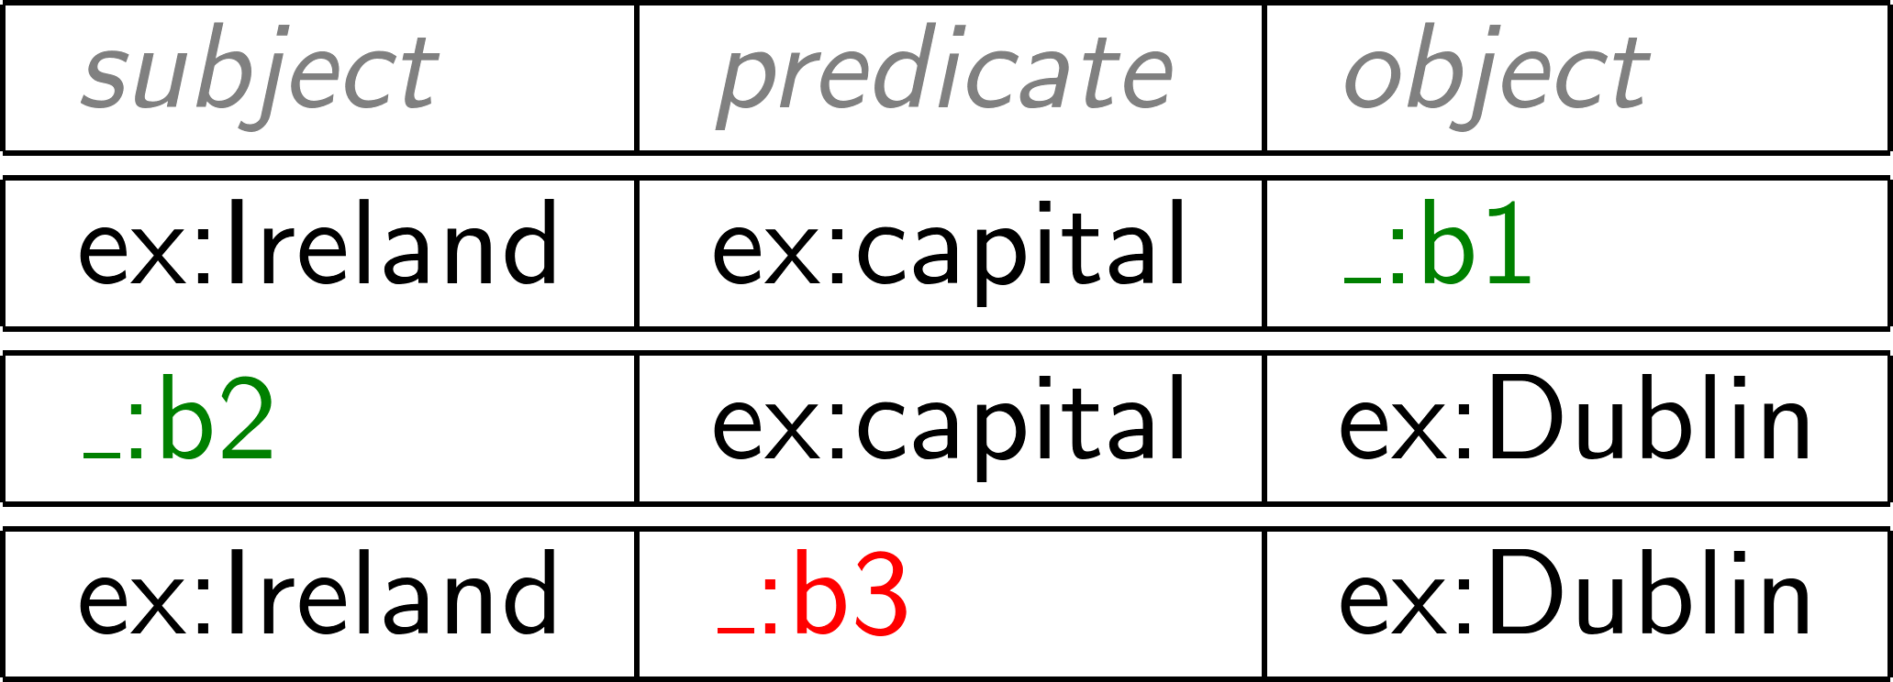
Blank nodes
Syntax: _:blankNode
Represents existence of something
Can only appear in subject or object position

Slide 35
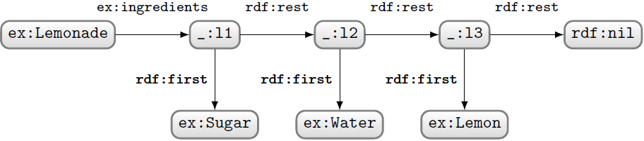

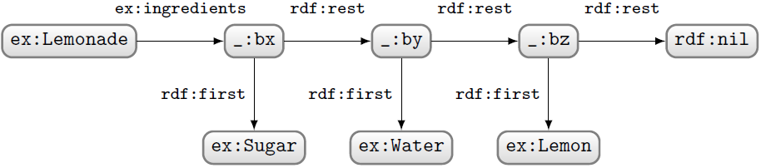
Blank node semantics

Slide 36
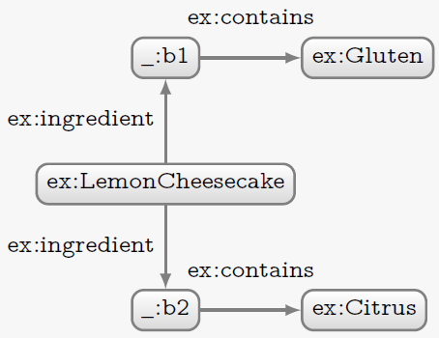
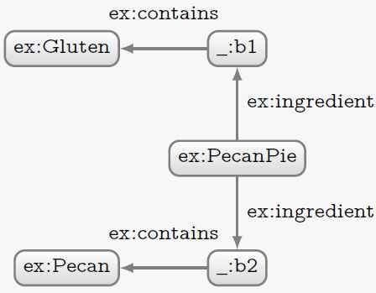
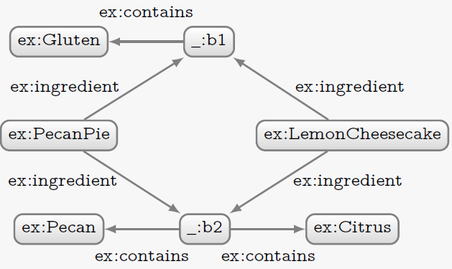
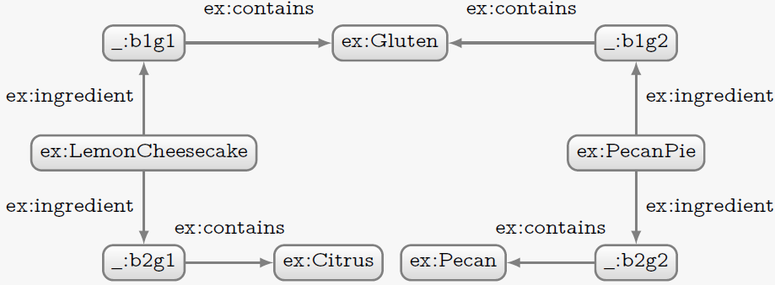
Blank nodes as local identifiers

Slide 37
“Blank nodes considered harmful”
They are fine for transient data that’s not meant to be stored.
They can be the only viable option if a changeable upstream data source doesn’t provide identifiers that persist across requests/updates.
They can be tolerable for unimportant auxiliary resources that don’t correspond to a meaningful entity in the domain of interest (e.g., some n-ary relations) and are not worth the hassle of maintaining a stable URI.
http://richard.cyganiak.de/blog/2011/03/blank-nodes-considered-harmful/

Slide 38
RDF model summary
 | Subject | Property | Object | Example
URI | Allowed | Allowed | Allowed | <http://john.mccr.ae/>
Blank Node | Allowed | Not Allowed | Allowed | _:bnode
Plain Literal | Not Allowed | Not Allowed | Allowed | "abcdef"
Typed Literal | Not Allowed | Not Allowed | Allowed | "10000"^^xsd:int
Lang-tagged Literal | Not Allowed | Not Allowed | Allowed | "Hello, world!”@en
Resources

Slide 39

Task
Let’s model something in RDF
Model the following in RDF:
“Sharknado is the first movie of the Sharknado series. It first aired on July 11, 2013. The movie stars Tara Reid and Ian Ziering. The movie was followed by ‘Sharknado 2: The Second One’.

Slide 40
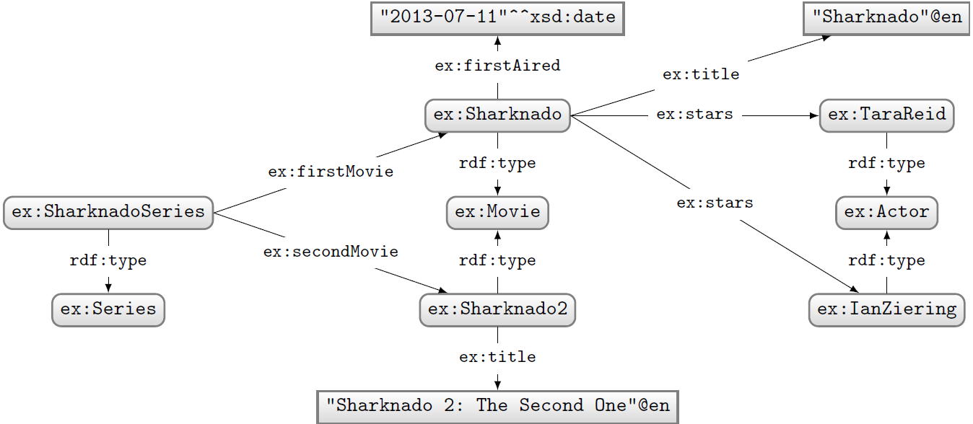
A solution

Slide 41
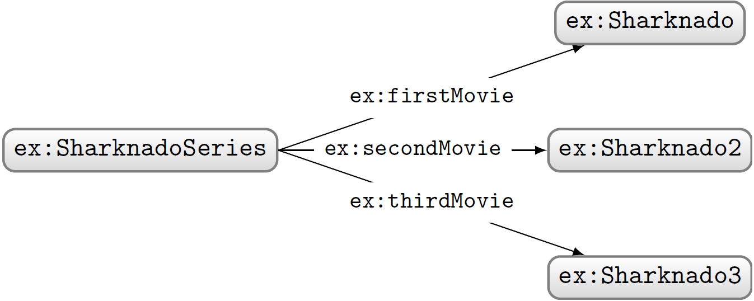
Modelling issues
Model the following in RDF:
“The first movie in the Sharknado series is ‘Sharknado’.
The second movie is ‘Sharknado 2: The Second One’.
The third movie is ‘Sharknado 3: Oh Hell No!’.

Slide 42
RDF Containers
Generic properties to show order using built-in properties rdf:_n
rdf:_1
ex:SharknadoSeries
ex:Sharknado
rdf:_2
ex:Sharknado2
rdf:_3
ex:Sharknado3

Slide 43
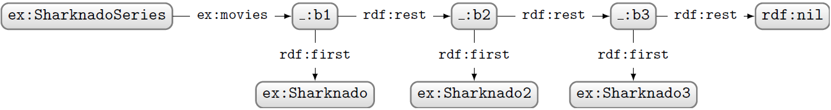
RDF Lists
Standard way to model linked lists in RDF
Use rdf:rest to link to rest of list
Use rdf:first to link to current member
Use rdf:nil to end the list

Slide 44
Discussion
What are the advantages/disadvantages of containers and lists?

Slide 45
Containers vs Lists
Containers use fewer triples
Containers are not complete (more elements can be added later)
No specific property associated with the container
Access is slower to lists

Slide 46
Summary
RDF models consists of
URIs
Blank Nodes
Literals (plain, typed, language-tagged)
Graph model can represent any data
Schema-less => flexible but with costs

